Slide 1
APLL INTERN CHALLENGE – 2025-26
RPA COE

Slide 2
Prerequisites
You need a GitHub account.
This account should have been created with the email id
you have given to us.
Student is expected to know how to work with GitHub.

Slide 3

Steps to Follow
Log in to your GitHub Account
1
5
Ignore the Error
Open new tab, paste URL, press enter
2
6
Go to your GitHub home page
Click & identify your email from the roster
3
7
Top right > Profile Icon > Organization
4
8
Click the organization and accept invite. Your Assignment Repo is now created.
Accept the assignment
Now you can pull the repo, start working, and commit changes.

Slide 4
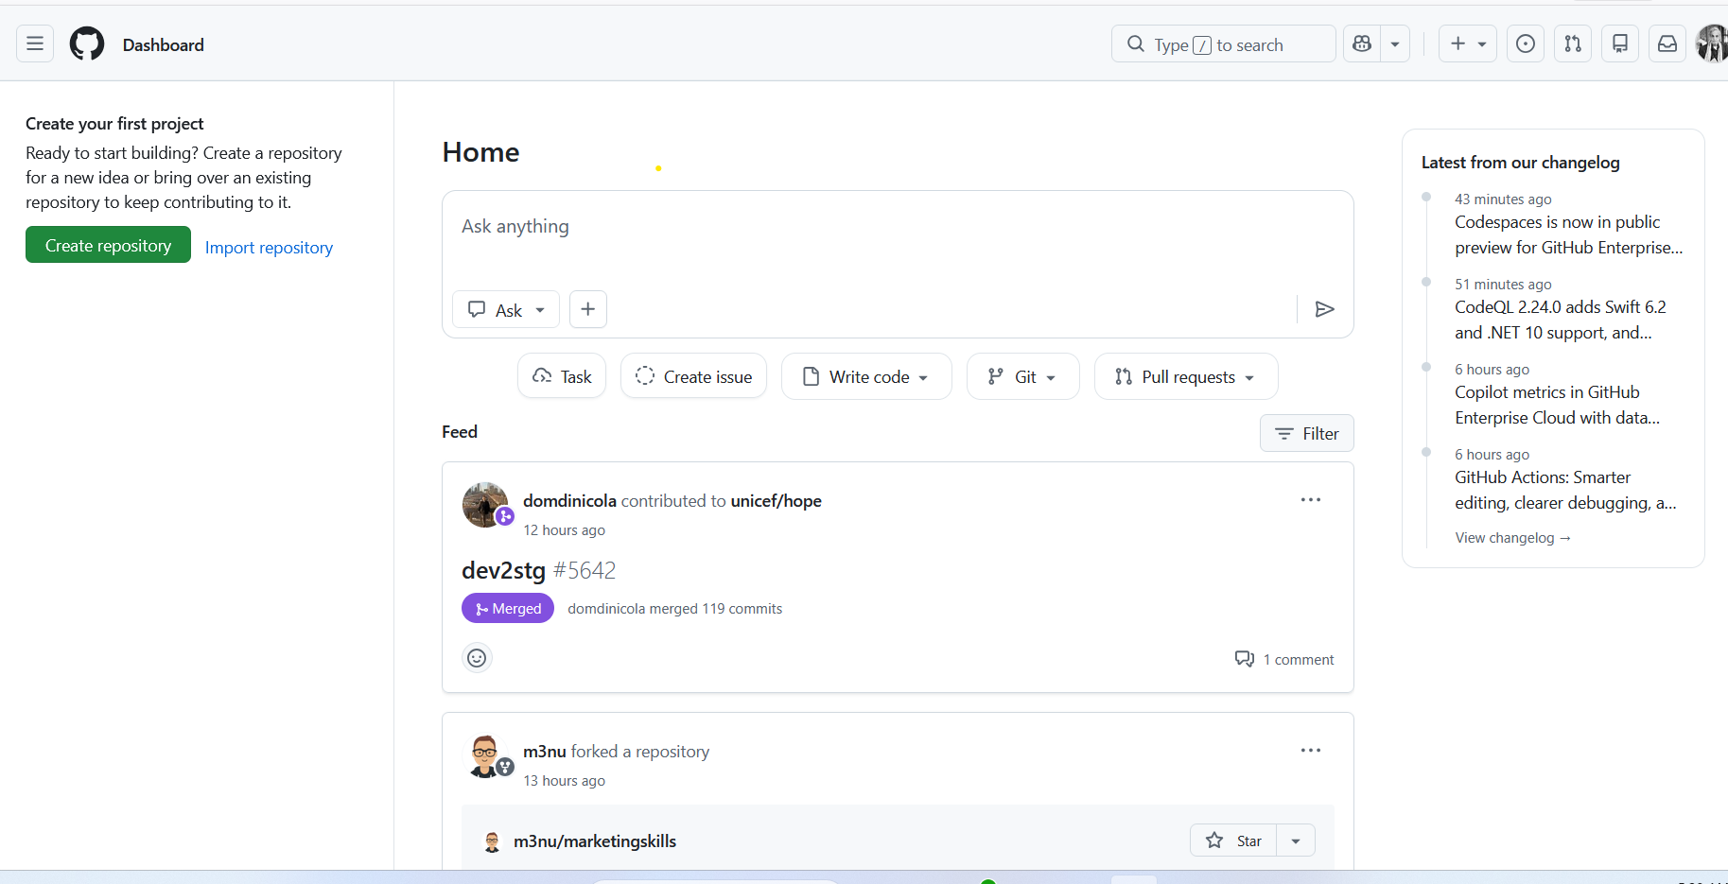
Step 1: Your home page may look like below

Slide 5
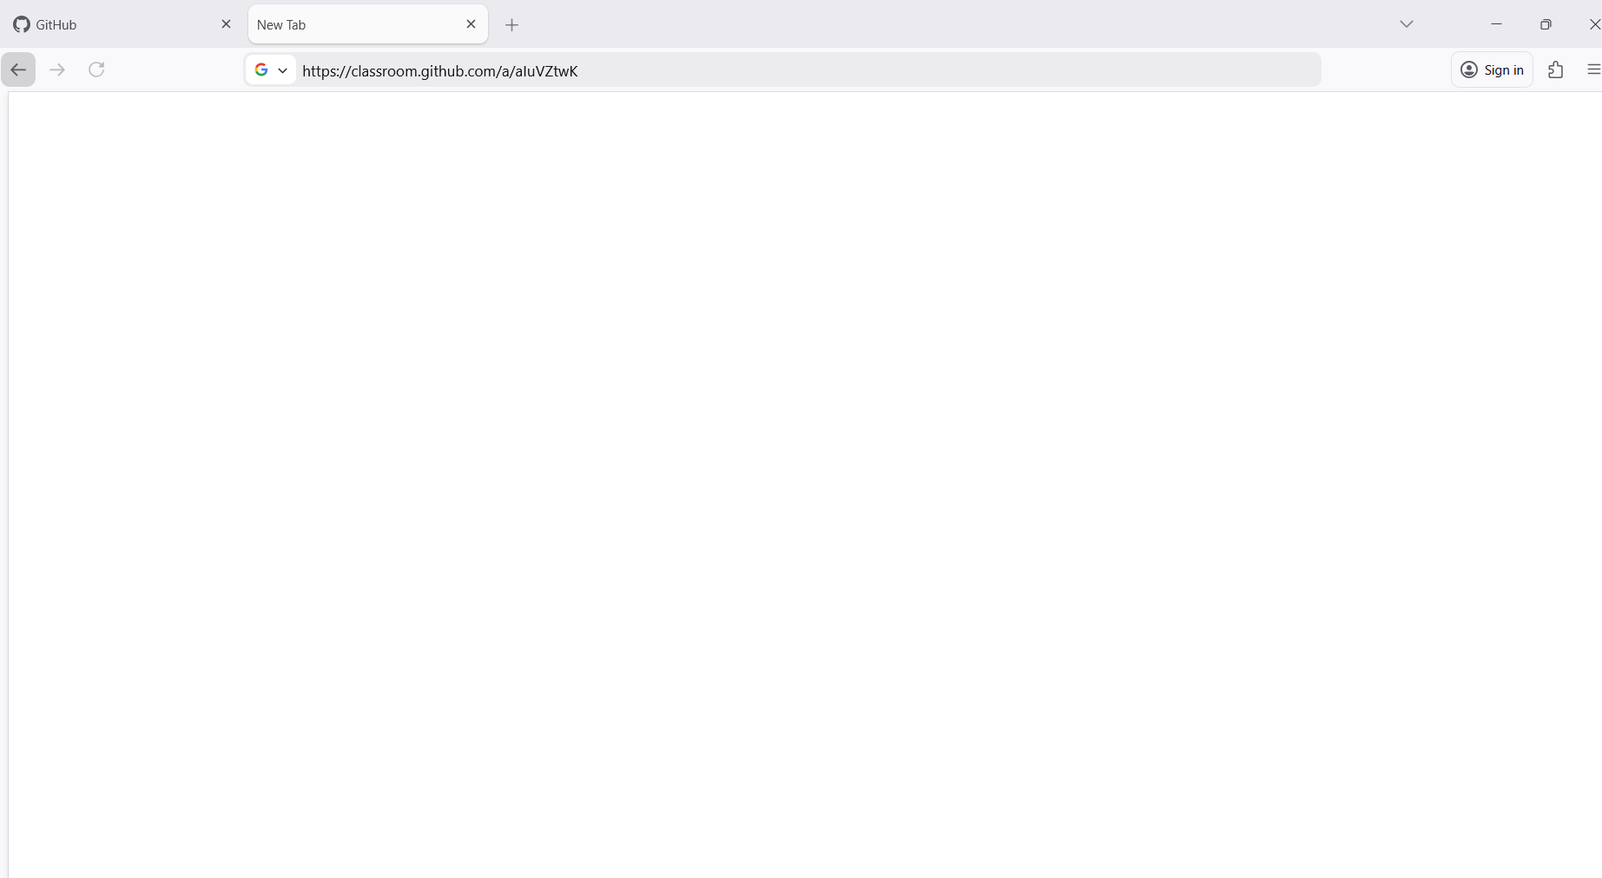
Step 2: Paste the assignment URL and press enter

Slide 6
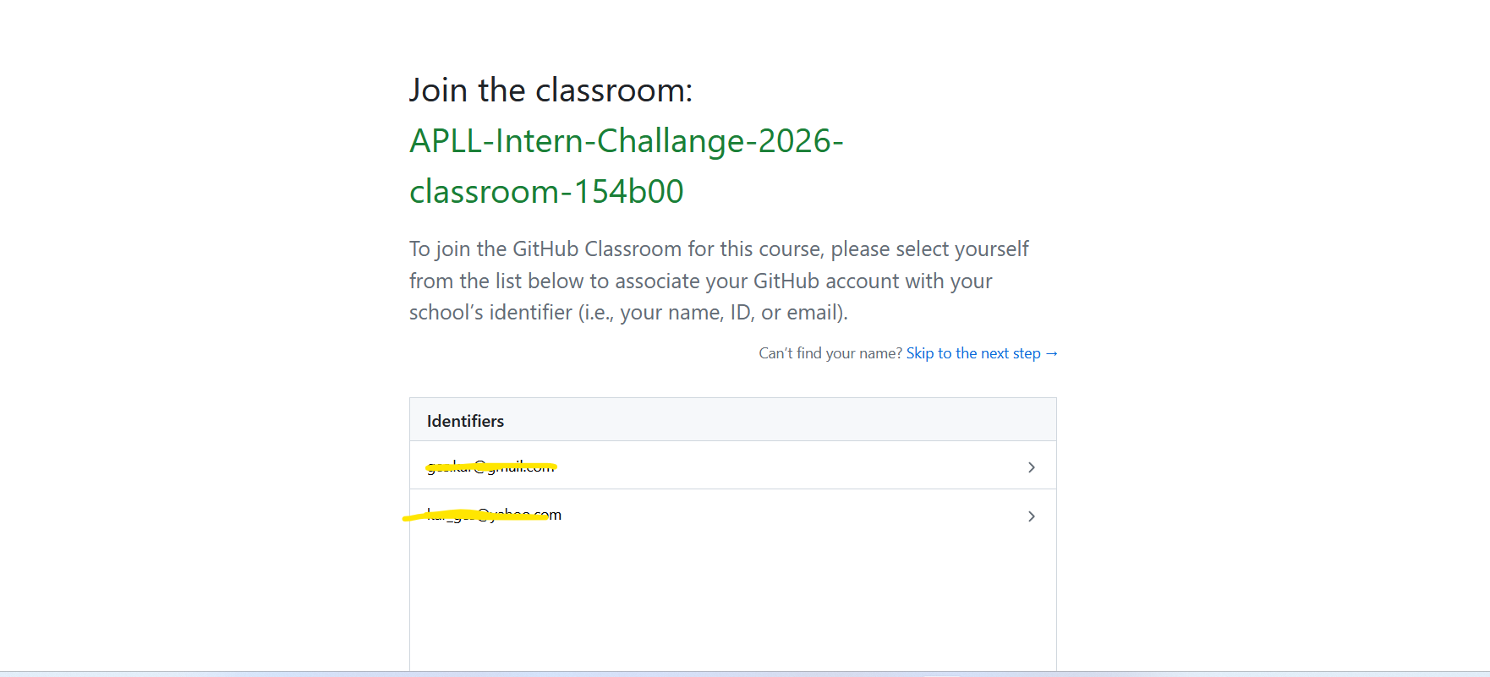
Step 3: Identify your email from the roster

Slide 7
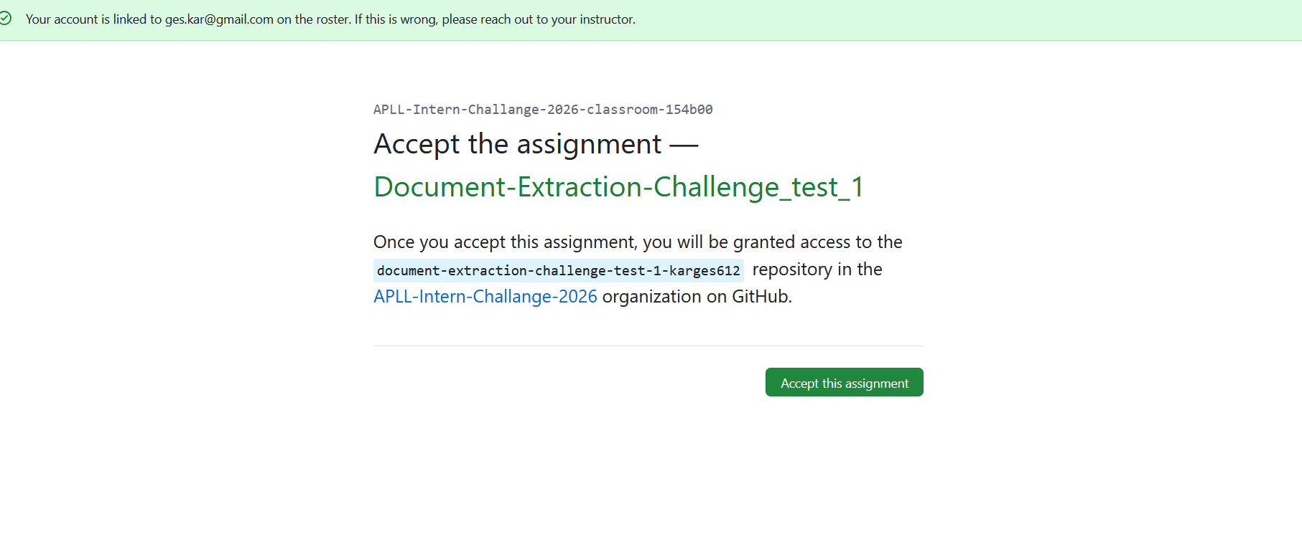
Step 4: Click and accept the assignment

Slide 8
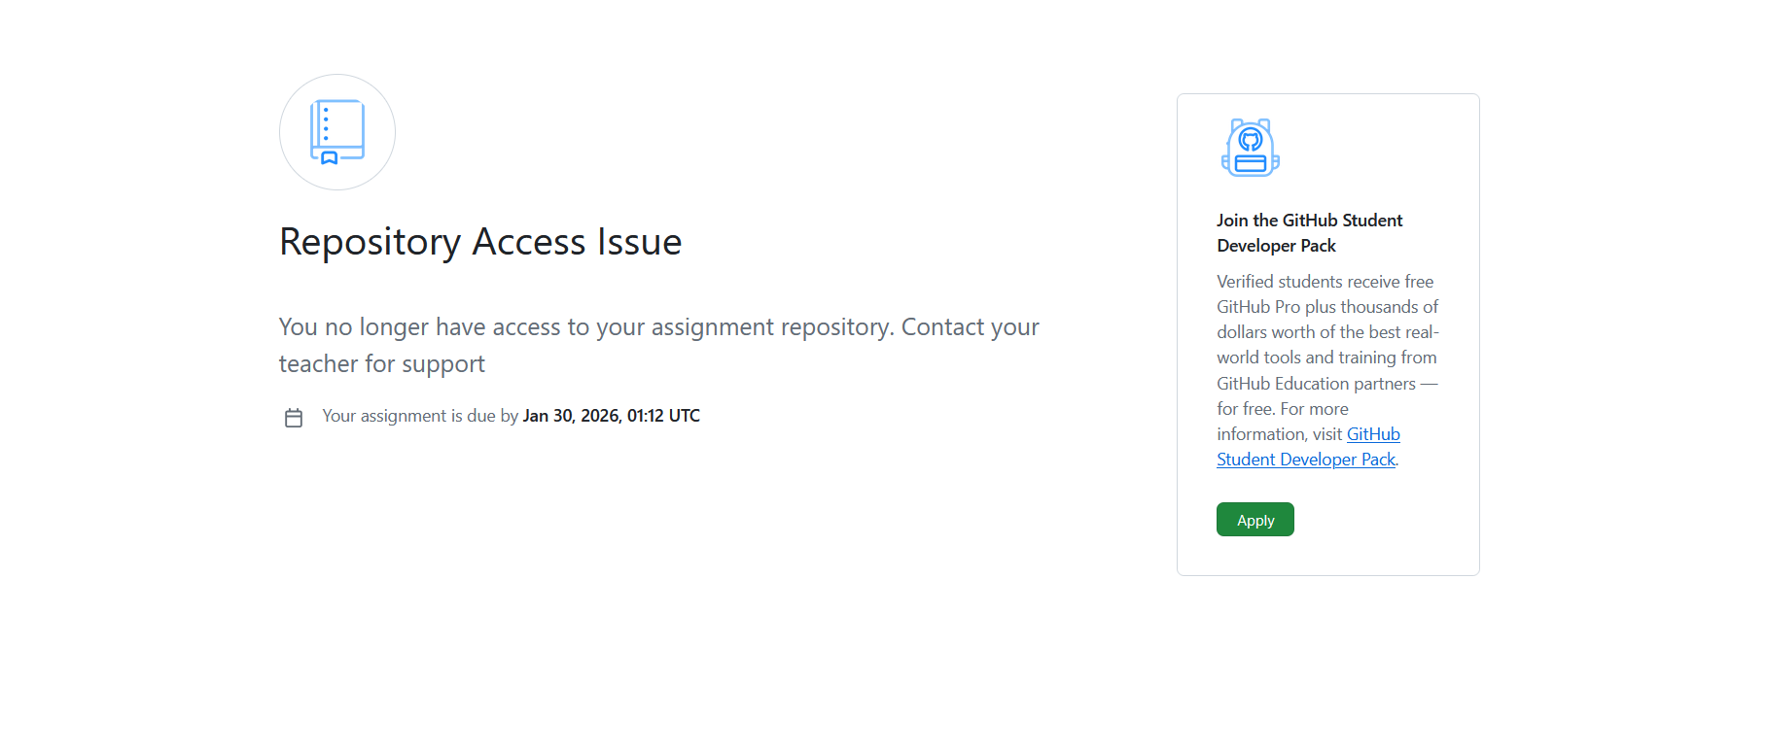
Step 5: Ignore the access error shown below

Slide 9
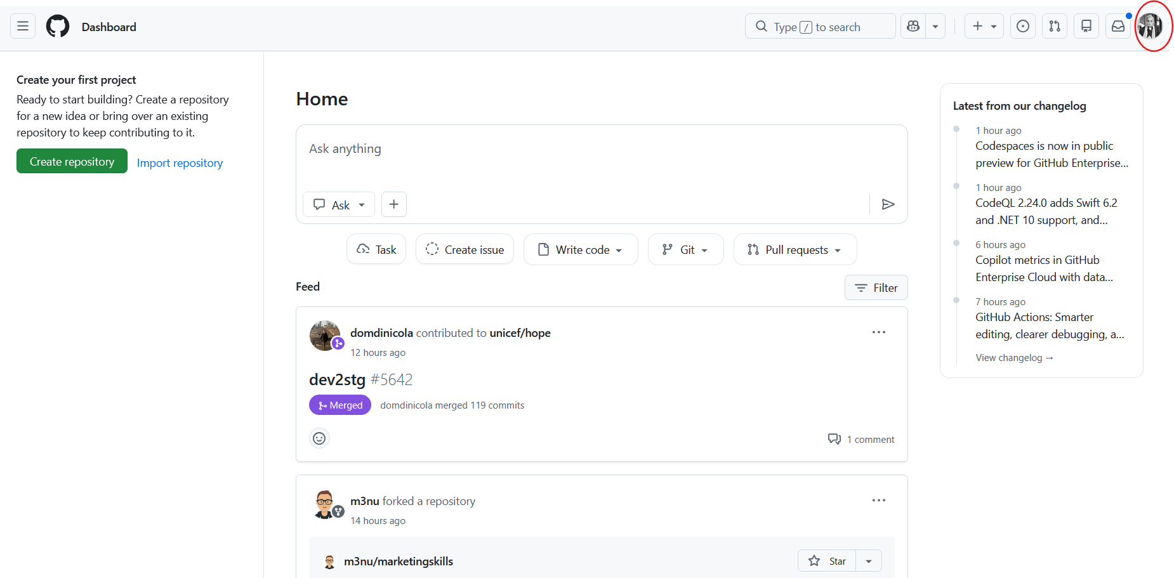
Step 6: Click top right profile icon

Slide 10
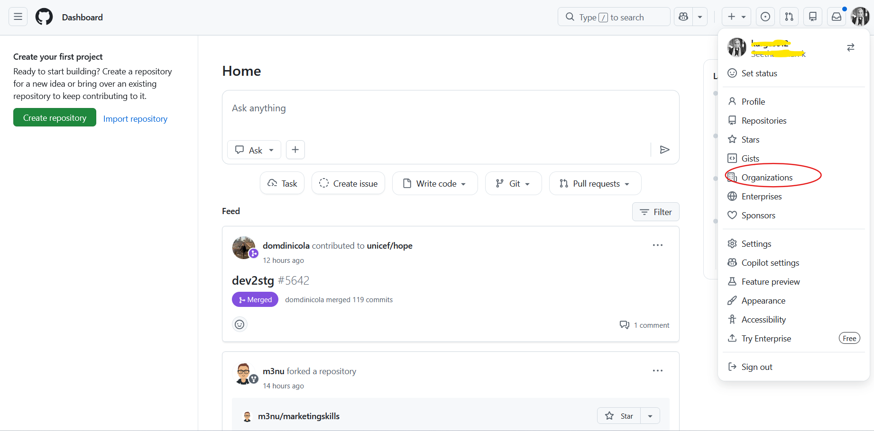
Step 7: Go to your org page

Slide 11
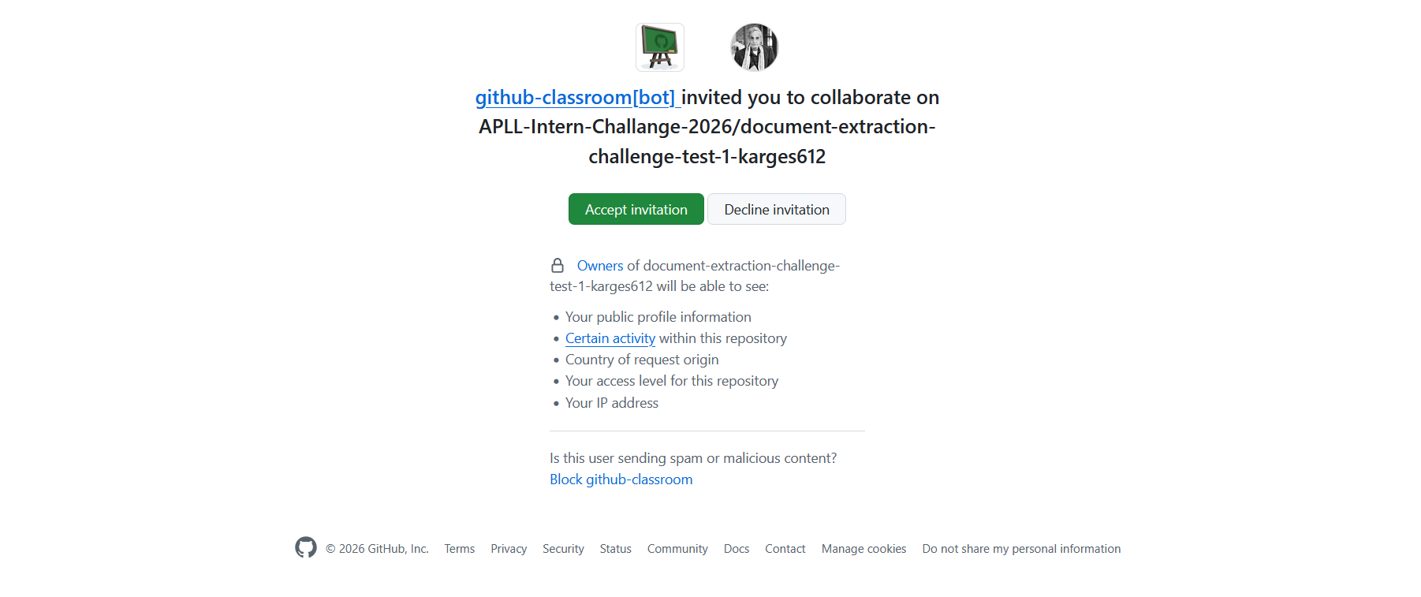
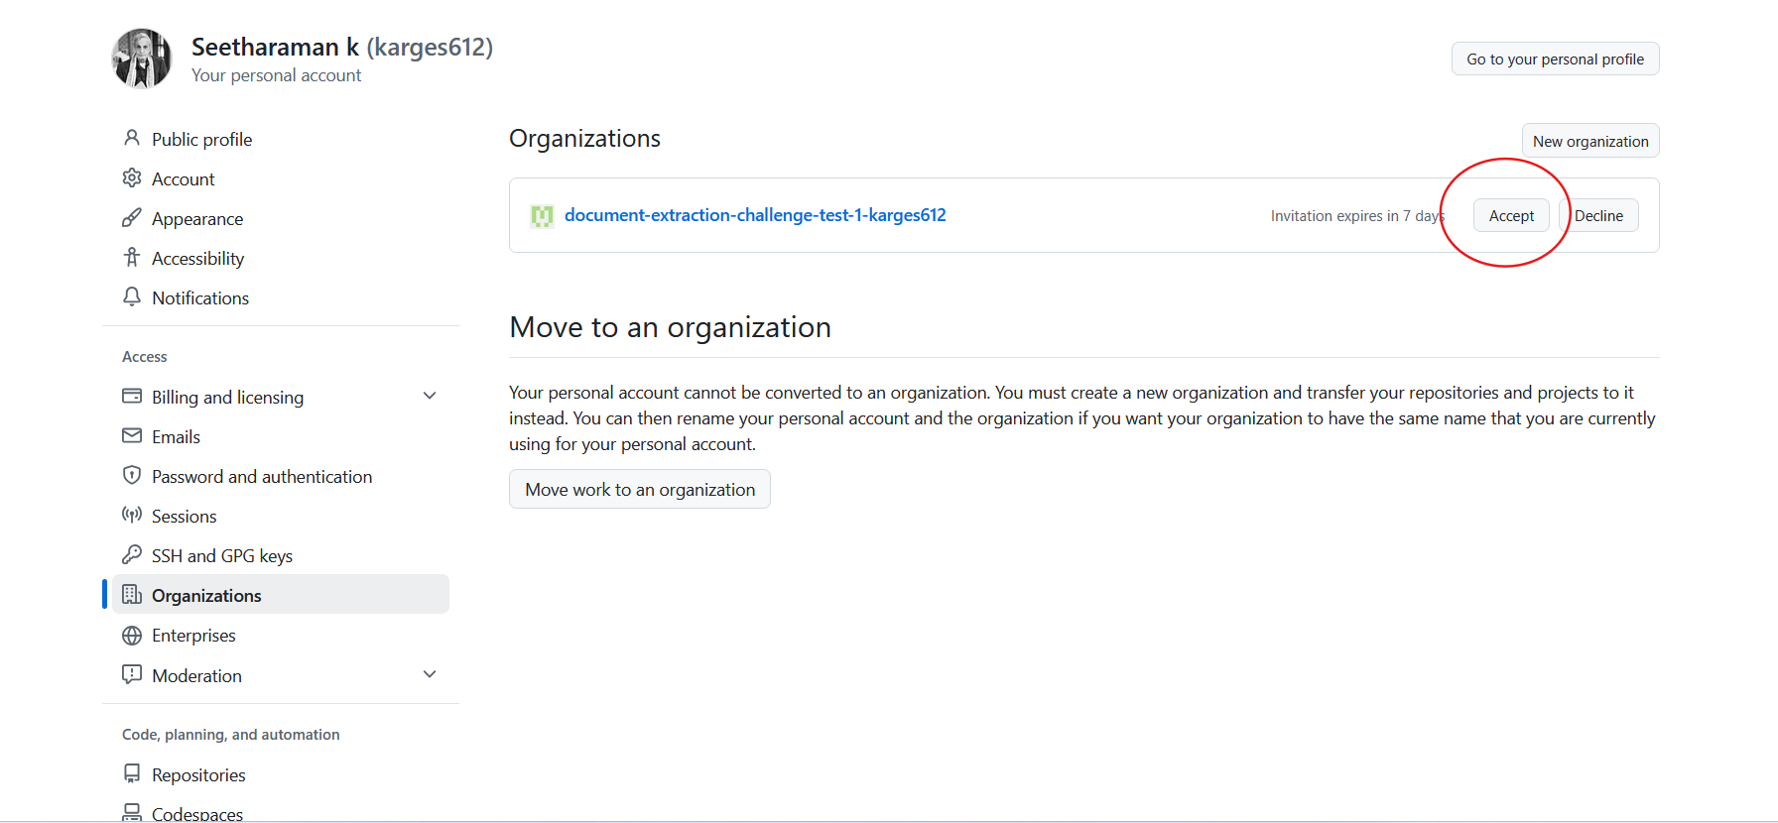
Step 8: Accept the invite from the org and then for assignment

Slide 12
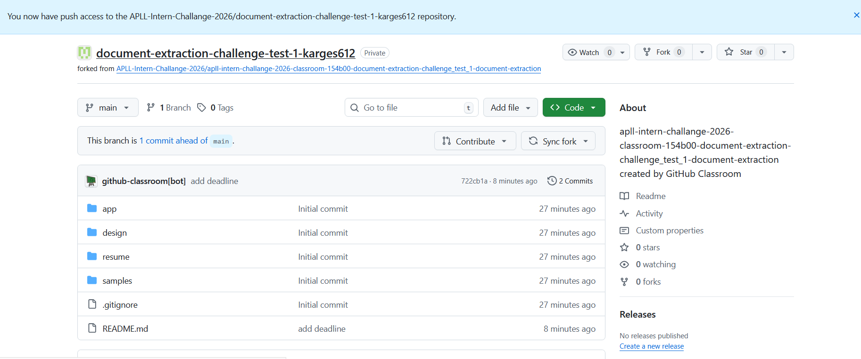
Step 9: Your repo is now created
Your repo is always accessible via the org page
****Please go through the README.md thoroughly before you start the exercise****

Slide 13
In case of issues
Visit our public template repository and raise issues.
Your issues will be public so everyone will be able to see it.
Raise issue only if it is very critical and stops you to proceed further.
Template repository link

